Slide 1
Basic SQL
COMP / IT 420
February 15th, 2021

Slide 2
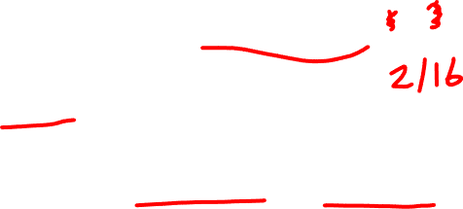
Class Outline
Homework 1 due at 11:59pm tomorrow night
Review of Lab 2
Database Class Project Full Proposal due 3/23/2021 at 11:59pm
Formal Introduction to Structured Query Language (will continue in lab)

Slide 3
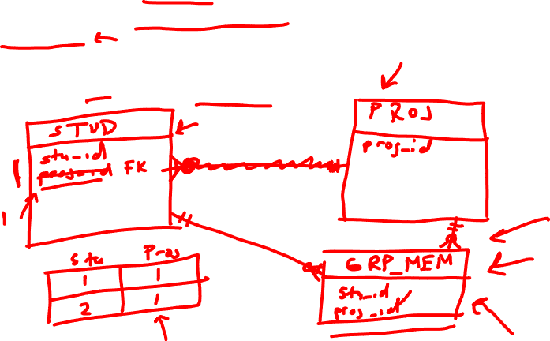
This simple DB will track:
student information (name, id, major)
project information (project name, id, description)
project groups
A project group can have many students. (Think about how to link students to projects.)
Each student can only work on a single project.

Slide 5

1 | 1/25/2021 | Course Orientation General Introduction to Databases | C&M Ch. 1
2 | 2/1/2020 | Database Models | C&M Ch. 2 & 4
3 | 2/8/2020 | Database Models Continued RDBMS and MySQL Course Project Initial Proposal Due 2/12 | C&M Ch. 3 & 4
4 | 2/15/2020 | SQL | C&M Ch. 7
5 | 2/22/2020 | Advanced SQL | C&M Ch. 8
6 | 3/1/2020 | Normalization | C&M Ch. 6
7 | 3/8/2020 | Mid-Term and Mid-Term Review

Slide 6
Learning Objectives
Data Definition Language (DDL)
Data Manipulation Language (DML)
https://dev.mysql.com/doc/refman/8.0/en/
More explicit description of what you’ve already seen

Slide 7
Before we begin
Get MySQL Workbench running on your machine so you can try things out as we go.
Load up SaleCo from last week’s lab.
Quiz questions will be MySQL based

Slide 8
Structured Query Language (SQL)
ANSI and ISO SQL
American National Standards Institute
International Organization for Standardization
Declarative, nonprocedural language
Command set of less than 100 words
Many SQL dialects with only minor differences
Learning one is basically learning all (but not quite!)

Slide 9
Categories of SQL
Data definition language (DDL)
defines the structure of the database
creating tables and constraints
Data manipulation language (DML)
allows for retrieval of database data
allows for creation and deletion of database data

Slide 10
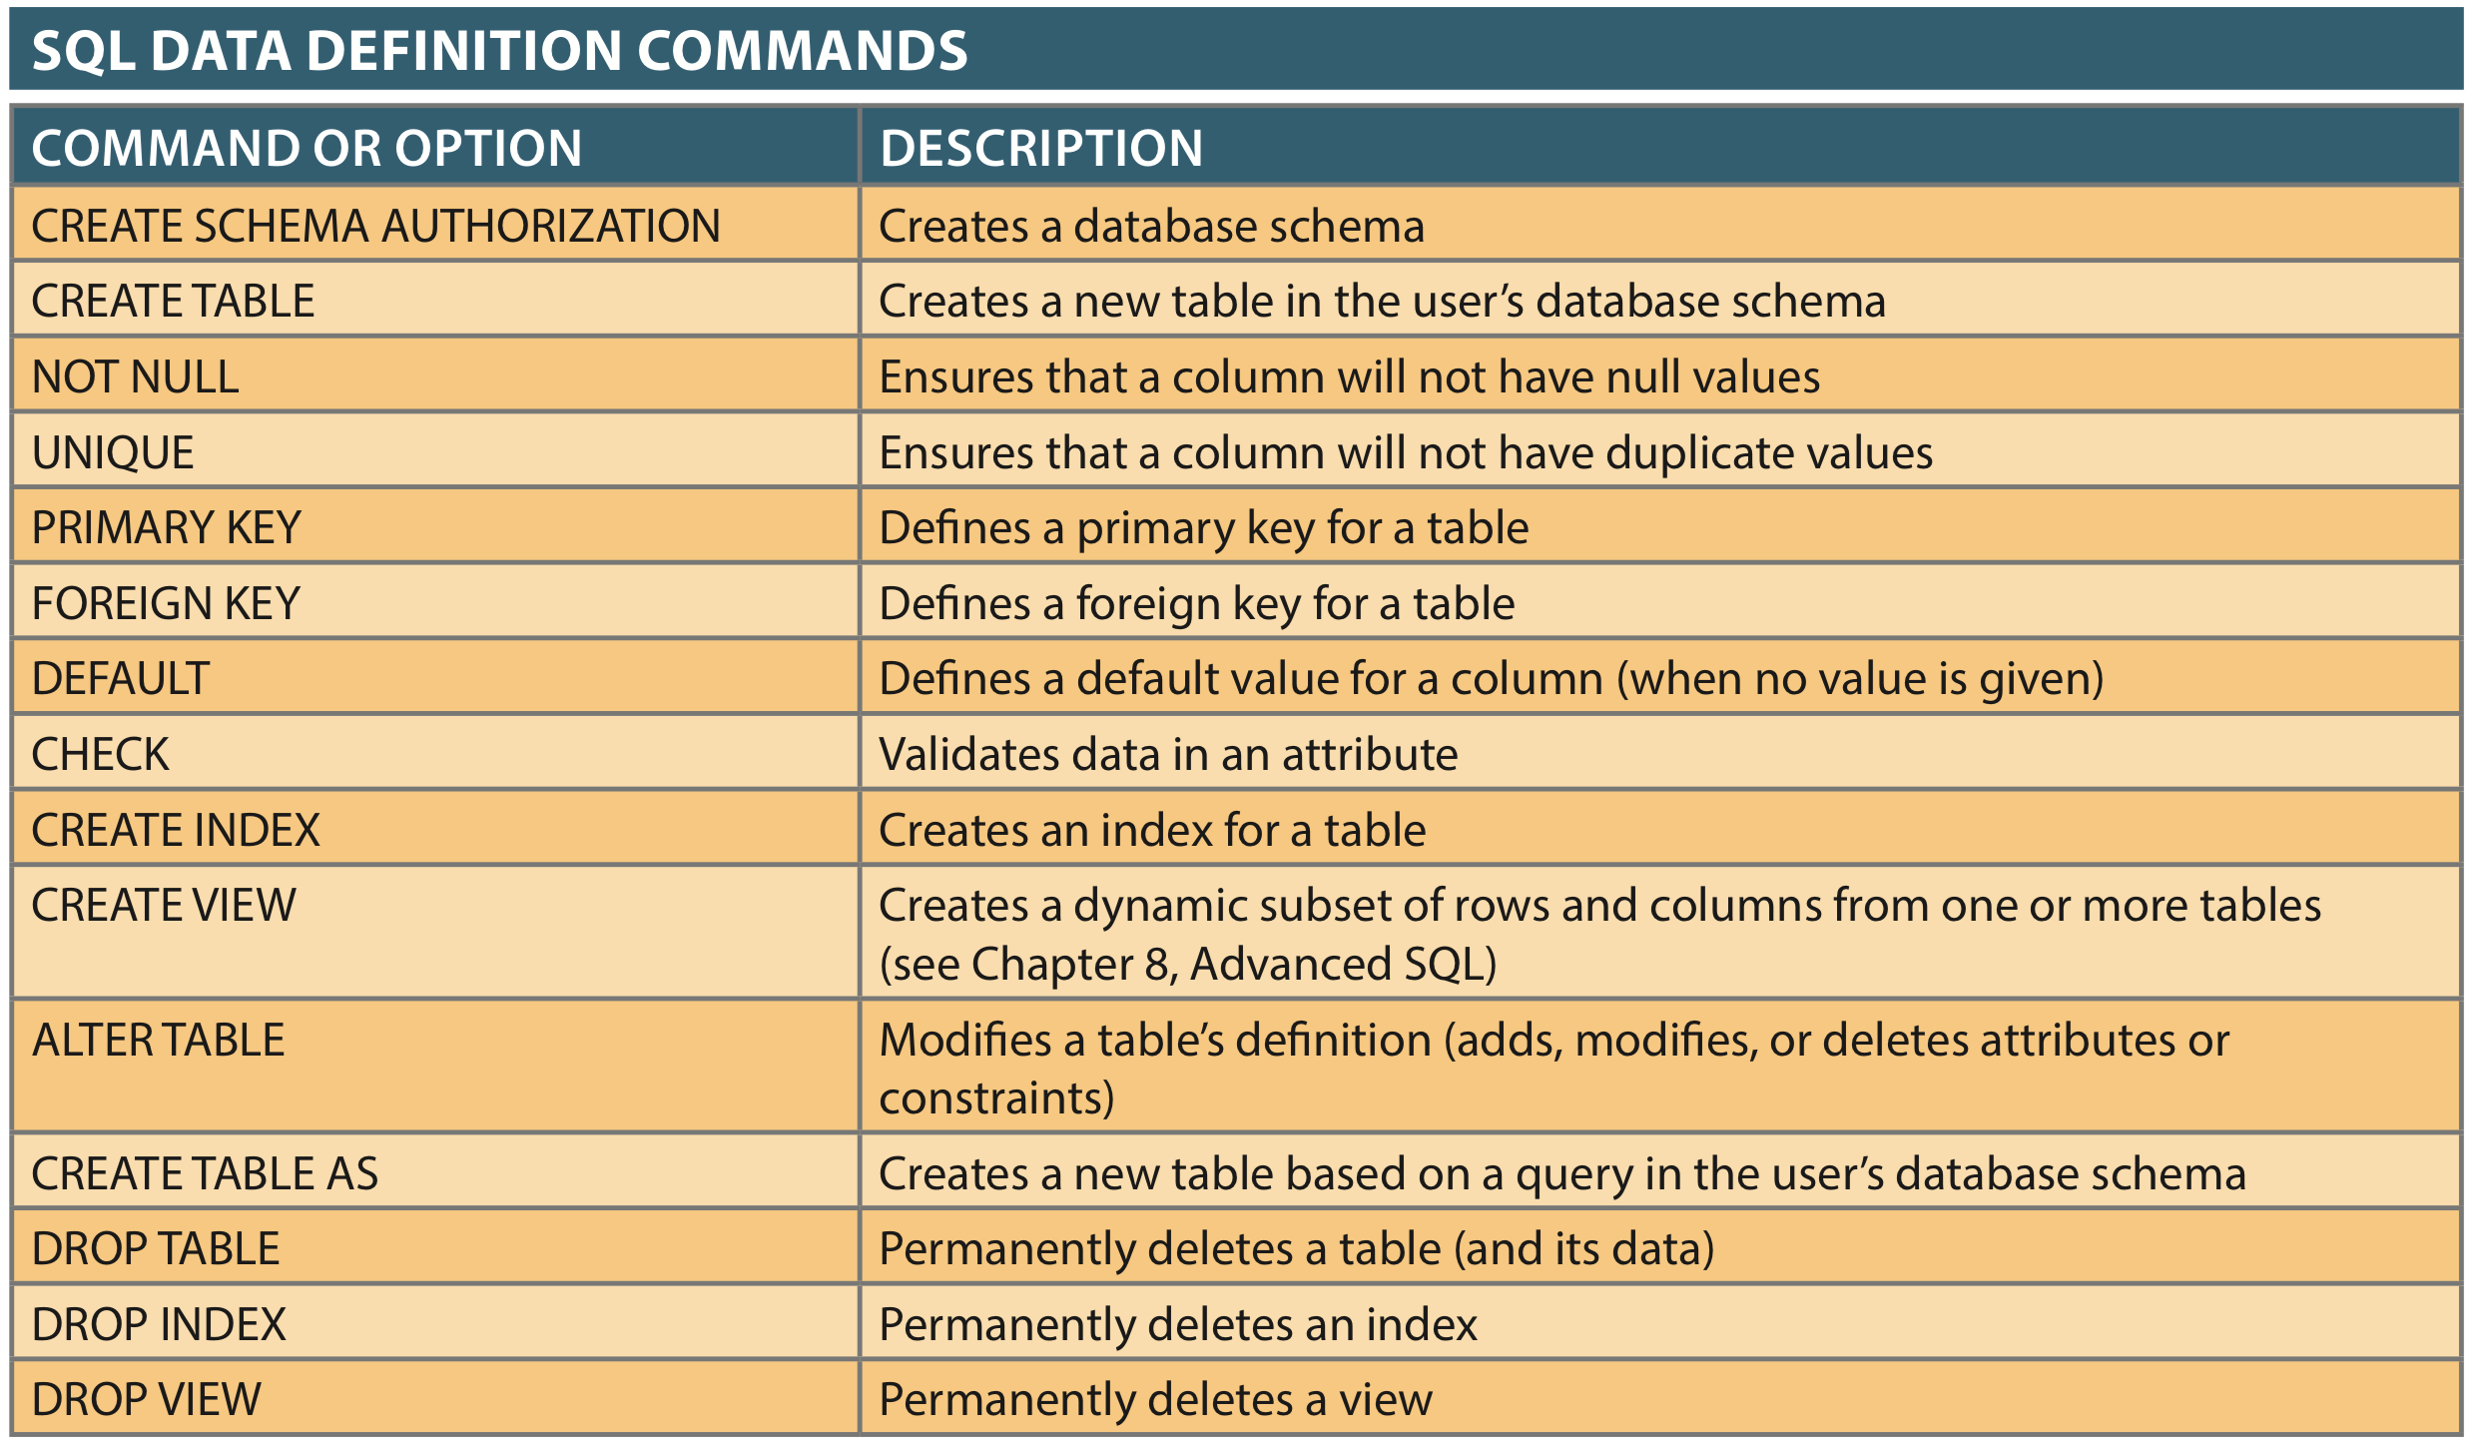

DDL Commands

Slide 11
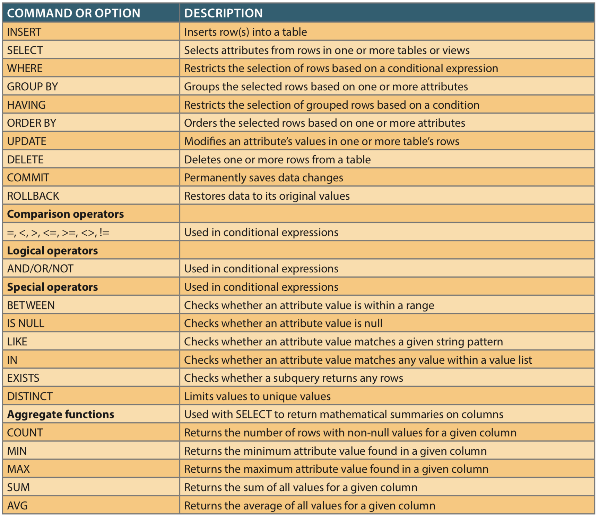
DML Commands

Slide 13
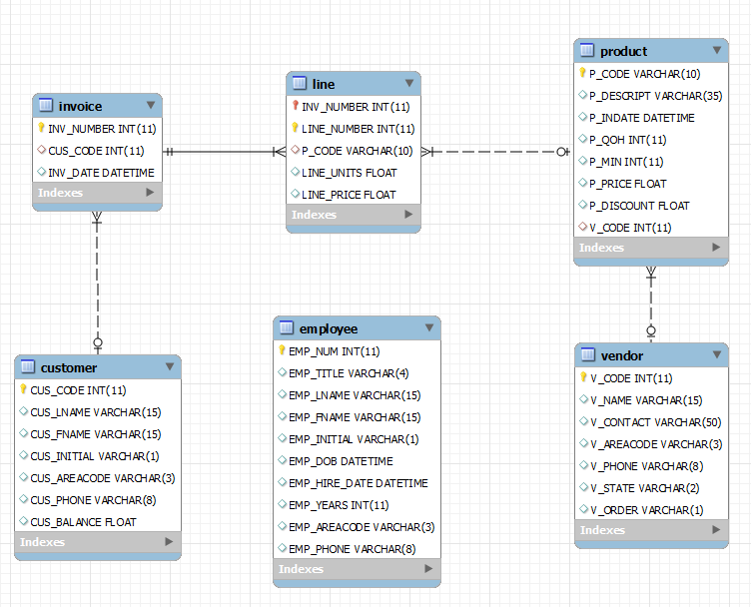

Database Model
Sale Co.!!!!

Slide 14

Where to Start?
Data Definition Language (DDL)
Conceptualize the database structure, including entities and relationships
Implement the structure
Create the database structure using DDL
Data dictionary
Physical Storage
Authentication and network will affect DDL permissions
Create tables in the database structure

Slide 15
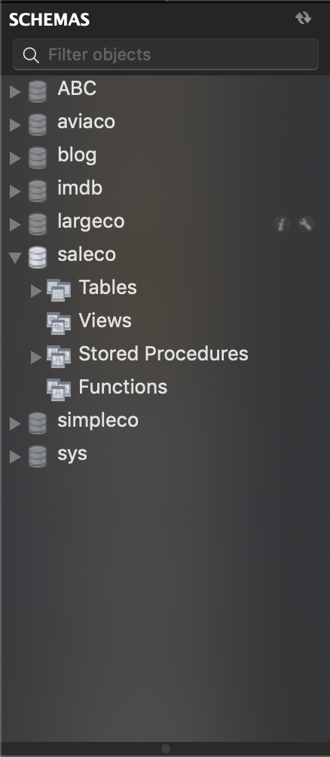
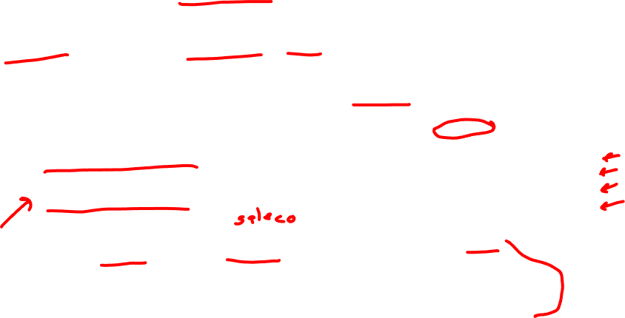
Database Schema
Logical grouping of DB objects (tables, views, stored procedures, etc.)
Allows a DBA to assign users to a single schema so that the user can only access the objects they are authorized to access.
CREATE SCHEMA <my_schema>;
CREATE DATABASE <my_database_name>;
MySQL “schema” and “database” are the same.

Slide 16
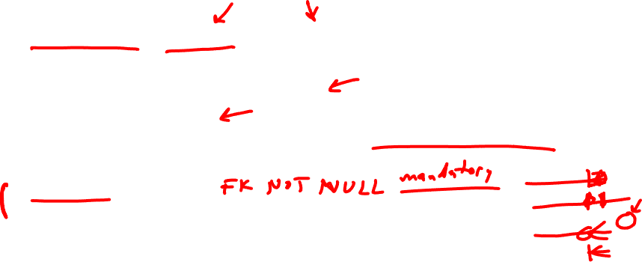
Creating Table Structures
Syntax to create table
CREATE TABLE tablename(field metadata);
Formatting Technique
Use one line per field (attribute) definition
Capitalize SQL commands
Line up attribute characteristics and constraints and follow order precedence.
Features of table creating command sequence
NOT NULL specification
UNIQUE specification

Slide 17
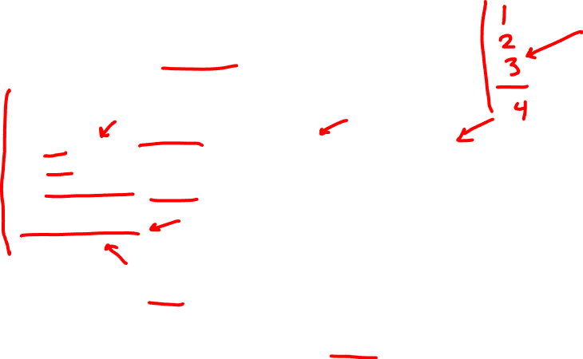
CREATE USER TABLE
Table creation command
CREATE TABLE USER
(
UID INT(9) NOT NULL AUTO_INCREMENT PRIMARY KEY, NAME VARCHAR (36) NOT NULL,
CREATED_ON DATETIME NOT NULL
)
ENGINE=INNODB;
Field metadata
InnoDB is transaction-safe engine, there are others available
with different effects on data retrieval and input.
Book may incorrectly state that MyISAM is default.

Slide 18
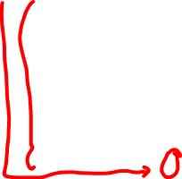
CREATE USER TABLE
CREATE TABLE USER
(
UID INT(9) NOT NULL AUTO_INCREMENT PRIMARY KEY, NAME VARCHAR (36) NOT NULL,
CREATED_ON DATETIME NOT NULL
)
ENGINE=INNODB;
SQL statements end with a semicolon (delimiter)
InnoDB is transaction-safe engine, there are others available
with different effects on data retrieval and input.
Book may incorrectly state that MyISAM is default.

Slide 19

Field Metadata
UID INT(9) NOT NULL AUTO_INCREMENT PRIMARY KEY
Field name, datatype, field constraints
Field name?
Datatype?
Constraints?

Slide 20
CREATE USER TABLE
Table creation command
CREATE TABLE USER
(
UID INT(9) NOT NULL AUTO_INCREMENT PRIMARY KEY, NAME VARCHAR (36) NOT NULL,
CREATED_ON DATETIME NOT NULL
)
ENGINE=INNODB;
Field metadata

Slide 21

Primary Key Constraint
UID INT(9) NOT NULL AUTO_INCREMENT PRIMARY KEY
PRIMARY KEY automatically enforces
NOT NULL
UNIQUE – non-duplicated
Can also be declared separately with:
PRIMARY KEY (UID)

Slide 22
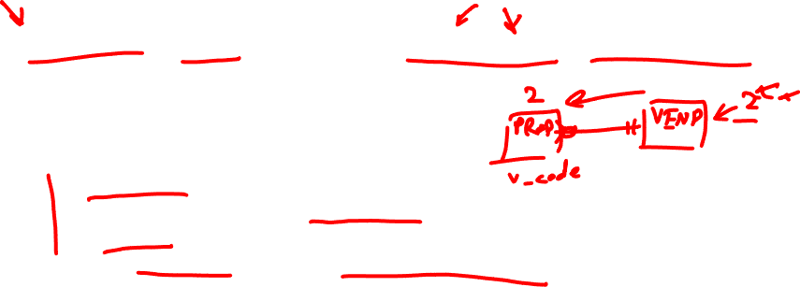
Foreign Key
FOREIGN KEY (V_CODE) REFERENCES VENDOR (V_CODE) ON UPDATE CASCADE
Enforced only if relationship is established.
ANSI SQL allows
ON DELETE CASCADE
If parent record is deleted, all foreign key records are deleted
ON UPDATE CASCADE
If parent record key is updated, update all foreign key records
SET NULL
SET DEFAULT

Slide 23

Composite Primary Key
CREATE TABLE LINE (
INV_NUMBER int,
LINE_NUMBER int,
P_CODE varchar(10),
LINE_UNITS float(8),
LINE_PRICE float(8),
PRIMARY KEY (INV_NUMBER, LINE_NUMBER),
FOREIGN KEY (INV_NUMBER) REFERENCES INVOICE(INV_NUMBER),
FOREIGN KEY (P_CODE) REFERENCES PRODUCT(P_CODE)
) ENGINE=INNODB;

Slide 24

Column Constraints
NOT NULL
Ensures that column does not accept nulls
UNIQUE
Ensures that all values in column are unique
DEFAULT
Assigns value to attribute when a new row is added to table
CHECK
Validates data when attribute value is entered

Slide 27

PRODUCT table
CREATE TABLE PRODUCT (
P_CODE VARCHAR(10) NOT NULL UNIQUE, P_DESCRIPT VARCHAR(35) NOT NULL, P_INDATE DATE NOT NULL, P_QOH SMALLINT NOT NULL, P_MIN SMALLINT NOT NULL, P_PRICE NUMBER(8,2) NOT NULL DEFAULT 0.00, P_DISCOUNT NUMBER(5,2) NOT NULL, V_CODE INTEGER, PRIMARY KEY (P_CODE), FOREIGN KEY (V_CODE) REFERENCES VENDOR (V_CODE) ON UPDATE CASCADE
);
Note default value for P_PRICE.

Slide 28

VENDOR table
CREATE TABLE VENDOR (
V_CODE int PRIMARY KEY,
V_NAME varchar(15),
V_CONTACT varchar(50),
V_AREACODE varchar(3) check(v_areacode =‘805’),
V_PHONE varchar(8),
V_STATE varchar(2),
V_ORDER varchar(1)
) ENGINE=INNODB;
Book may incorrectly state that CHECK
is ignored in MySQL.
Always check current documentation.

Slide 29
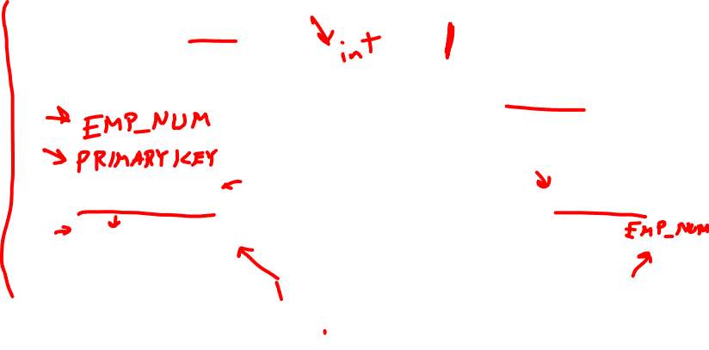
Quiz! Sale Table
Run this completed command to create your table.
SALE_ID is primary key
EMP_NUM and INV_NUMBER are foreign keys.
Write “CALAMITY” instead of red text below.
CREATE TABLE SALE (
SALE_ID _____,
INV_NUMBER int,
__________ int,
__________ (SALE_ID),
FOREIGN KEY (INV_NUMBER) REFERENCES INVOICE(INV_NUMBER),
___________ (EMP_NUM) REFERENCES EMPLOYEE(______)
) ENGINE=INNODB;

Slide 30
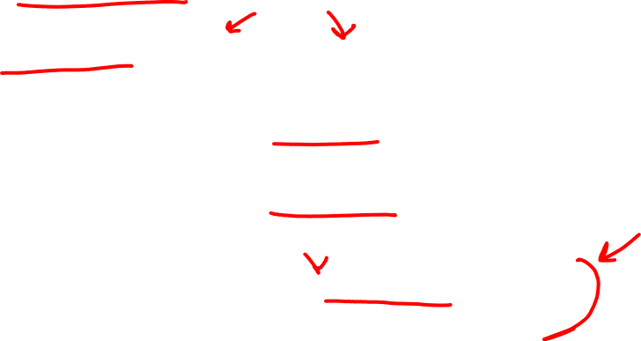
ALTER TABLE
ALTER TABLE table alter_specification
ALTER TABLE vendor DROP COLUMN v_name;
ALTER TABLE vendor ADD COLUMN v_location varchar(40);
ALTER TABLE vendor ADD FOREIGN KEY (v_key) REFERENCES other_table(v_key);

Slide 31

MySQL Datatypes (DATE)
- DATE, DATETIME, and TIMESTAMP
- TIME
- YEAR
- DATE in MySQL accepts STR or INT
19980909 or ‘1998-09-09’
- TIMESTAMP on INSERT (more later)

Slide 32


MySQL Datatypes (NUMERIC)
- Integer Types
- INTEGER, INT, SMALLINT, TINYINT, MEDIUMINT, BIGINT
- Fixed-Point Types (Exact Value)
- DECIMAL, NUMERIC
- Floating-Point Types (Approximate Value)
- FLOAT, DOUBLE
- Bit-Value Type
- BIT

Slide 33

MySQL Datatypes (CHARACTER)
- CHAR and VARCHAR
- BINARY and VARBINARY
BLOB and TEXT (binary string and non-binary string, respectively)
longer text
arbitrary string data
ENUM
single choice from a set of values
SET
multiple choices from a set of values

Slide 34
Break!
Next up is SQL DML commands!

Slide 35
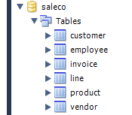

Play along with SALECO DB

Slide 36

Data Manipulation Commands
INSERT: Command to insert contents to a table
SELECT: Command to list the contents
Syntax - SELECT columnlist FROM tablename;
Wildcard character(*) to retrieve all columns
UPDATE: Command to modify data
Syntax - UPDATE tablename SET columnname = expression [, columnname = expression] [WHERE conditionlist];
Syntax - INSERT INTO tablename (columnlist) VALUES (values);
Syntax - INSERT INTO tablename SELECT columnlist FROM tablename;

Slide 37
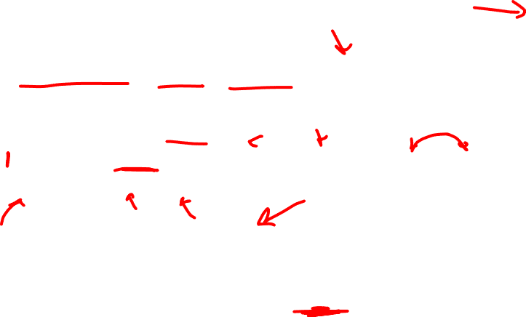
Inserts into SALECO
INSERT INTO table VALUES (value1, value2...);
INSERT INTO vendor
VALUES (24543, ‘CSUCI’, ‘Ekho’, ‘805’, ‘111-1111’, ‘CA’, ‘Y’);
INSERT INTO product
VALUES (‘8050-EKHO’, ‘Ekho Dolphin Chow’, 20190916, 10,10,18.99,0,24543);
Is order important?

Slide 38

Quiz Inserts
INSERT INTO sale VALUES (1, 1001, 100);
INSERT INTO sale VALUES (2, 1008, 100);
INSERT INTO sale VALUES (3, 1003, 101);
INSERT INTO sale VALUES (4, 1005, 101);
INSERT INTO sale VALUES (5, 1006, 101);
INSERT INTO sale VALUES (6, 1007, 101);

Slide 39
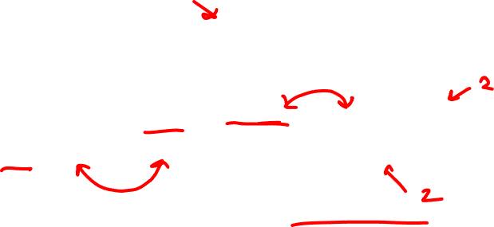
Insert without all values
INSERT INTO table(attribute_1,attribute_2,...) VALUES (attribute_1_value, attribute_2_value, ...)
INSERT INTO product(p_code, p_descript) VALUES (‘BRT-345’, ‘Titanium drill bit’)
What happens to other values in record?

Slide 40

Update
UPDATE table
SET attribute = value, ...
WHERE condition;
UPDATE product
SET p_indate = 20160118
WHERE p_code = '13-Q2/P2’;
What do you think happens if you don’t use WHERE condition?

Slide 41

Data Manipulation Commands
DELETE command
DELETE FROM table WHERE conditions;
Not using WHERE will delete all rows.
WHERE command
specifies which rows to return after rows have been selected
conditions against which to check each row in results

Slide 42
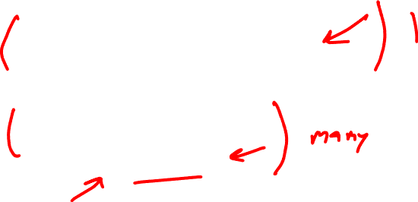
DELETE
DELETE FROM table WHERE condition;
DELETE FROM product
WHERE p_code = ‘BRT-345’;
DELETE FROM product
WHERE p_min = 5;
Set operation like UPDATE! Use with caution!

Slide 43
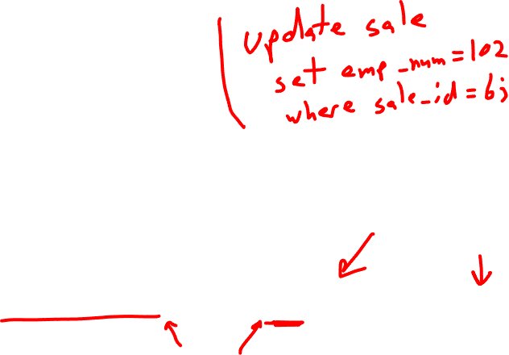
Quiz Change Data
Oops!
INSERT INTO sale VALUES (1, 1001, 100);
INSERT INTO sale VALUES (2, 1008, 100);
INSERT INTO sale VALUES (3, 1003, 101);
INSERT INTO sale VALUES (4, 1005, 101);
INSERT INTO sale VALUES (5, 1006, 101);
INSERT INTO sale VALUES (6, 1007, 101);
This should be 102!

Slide 44

Selecting Rows Using Conditional Restrictions
Rows are restricted based on the conditions list:
SELECT column_list (attributelist)
FROM table_list
[WHERE condition_list];
Used to select partial table contents by placing restrictions on the rows
Optional WHERE clause
Adds conditional restrictions to the SELECT statement

Slide 45
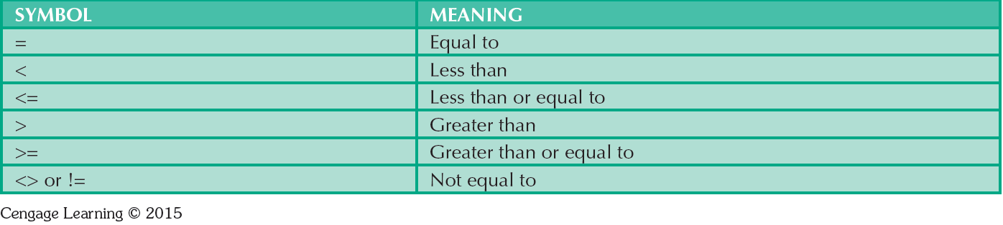

Comparison Operators
Will not work with NULL
Can use with datatypes other than numbers

Slide 46

Arithmetic Operators
Addition (+)
Subtraction (-)
Multiplication (*)
Division (\)
Integer Division (‘DIV’)
Modulus (%, ‘MOD’)
Overflow is possible
Fields must allow for operation

Slide 47
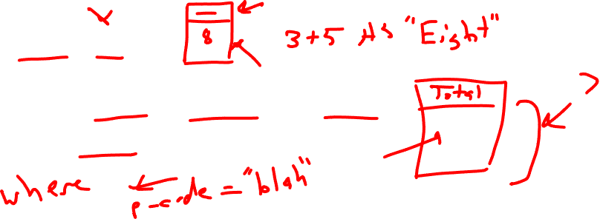
Arithmetic Operators
SELECT 3+5;
SELECT p_qoh * p_price AS “Total”
FROM product;

Slide 48
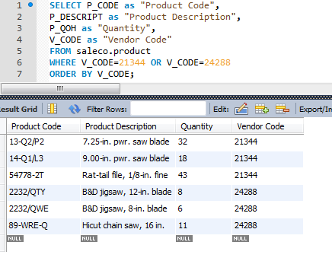
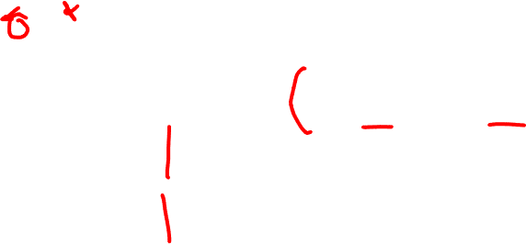
Compound Statements (logical OR)
Select all products by
vendor 21344 or vendor 24288.

Slide 49
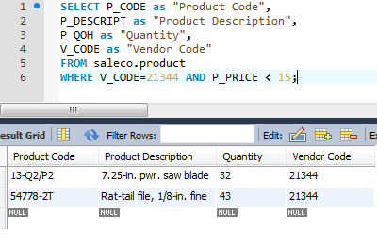

Compound Statements (logical AND)
Select all products by vendor 21344
that are less than $15.

Slide 50
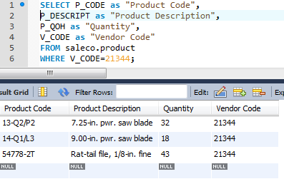

Alias (AS)
Alternate name given to
a column or table in any SQL statement

Slide 51
Special Operators
BETWEEN
IS NULL
LIKE
IN
EXISTS
Checks whether attribute value is within a range
Checks whether attribute value is null
Checks whether attribute value matches given string pattern
Checks whether attribute value matches any value within a value list
Checks if subquery returns any rows

Slide 52
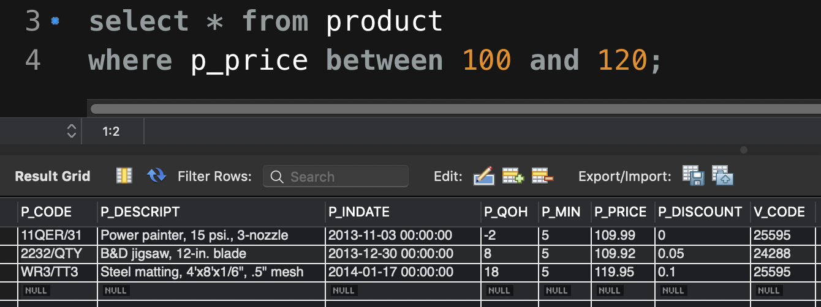

BETWEEN

Slide 53
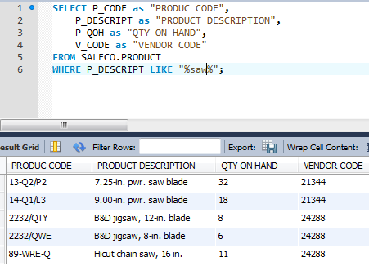

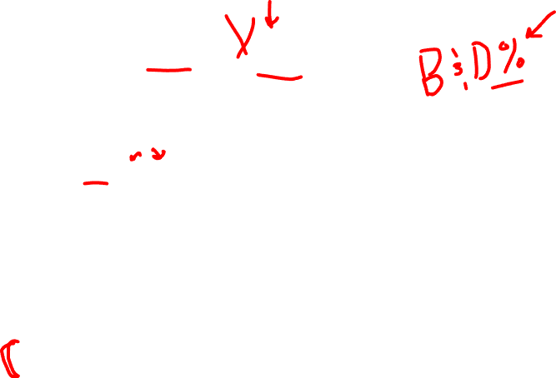
Find products LIKE %saw%

Slide 54
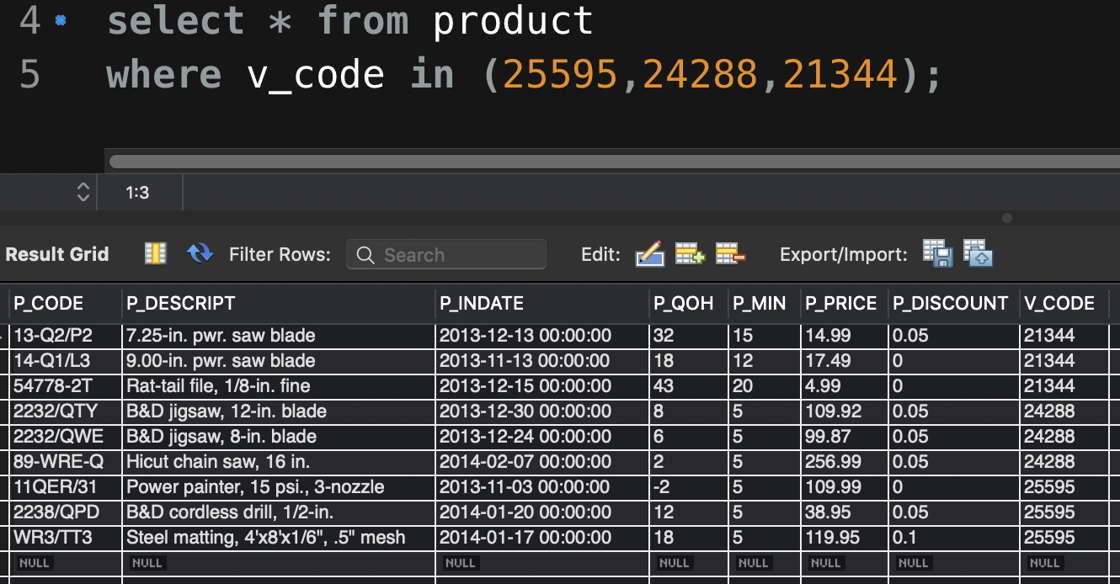
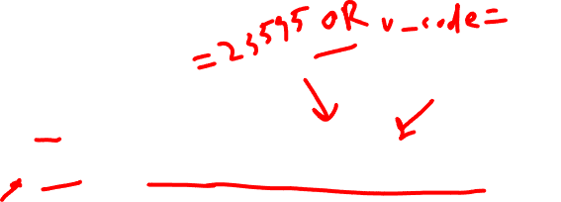
IN

Slide 55
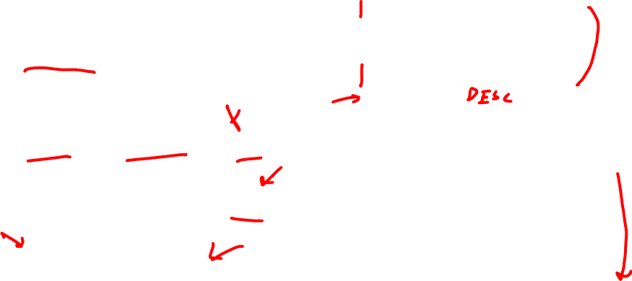
Ordering
ORDER BY clause selects ordering behavior
ORDER BY attribute ASC
ORDER BY attribute DESC
ORDER BY attr_1, attr_2, ...

Slide 56
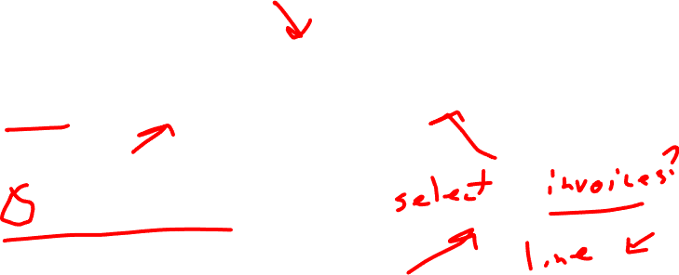
Quiz
Based on the information you entered into the SALE table earlier, which employee had the largest individual sale?
103 is the calamity option

Slide 57

Listing Unique Values
DISTINCT clause produces list of values that are unique
SELECT DISTINCT column_list FROM table_list;
Based entirely on SELECT attributes (columns)

Slide 58
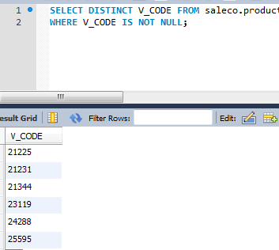

DISTINCT

Slide 59

Joining Database Tables
- Used to retrieve like data from multiple tables
- Uses the equality comparison between foreign and primary keys
- Tables are joined by listing tables in FROM clause of SELECT statement
- Without a join, the RDBMS creates Cartesian product of every table in the FROM clause

Slide 60
Relationships in SALECO

Slide 61
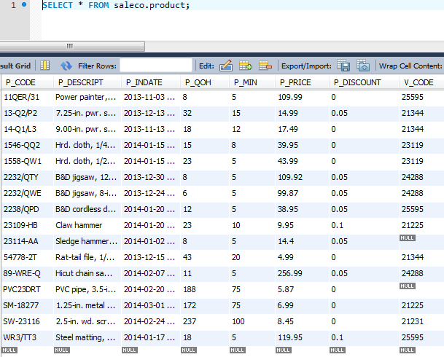
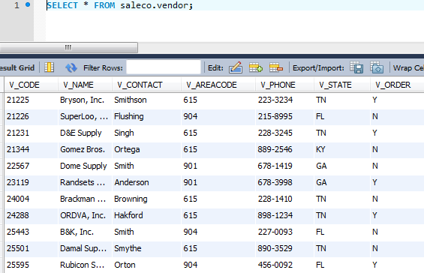
PRODUCT and VENDOR

Slide 62
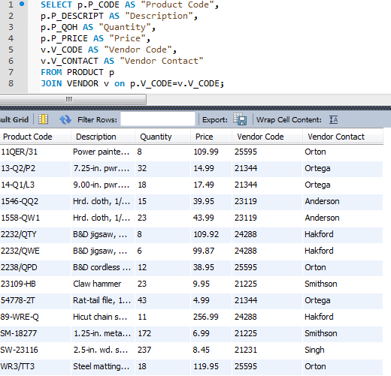


Slide 63

SQL Joins
- Natural join - Common values in common columns
- Generally avoided
- Equality or inequality - Meet a given join condition
- Outer join: Common values in common columns or no matching values
- Inner join: Only rows that meet a given criterion are selected

Slide 64
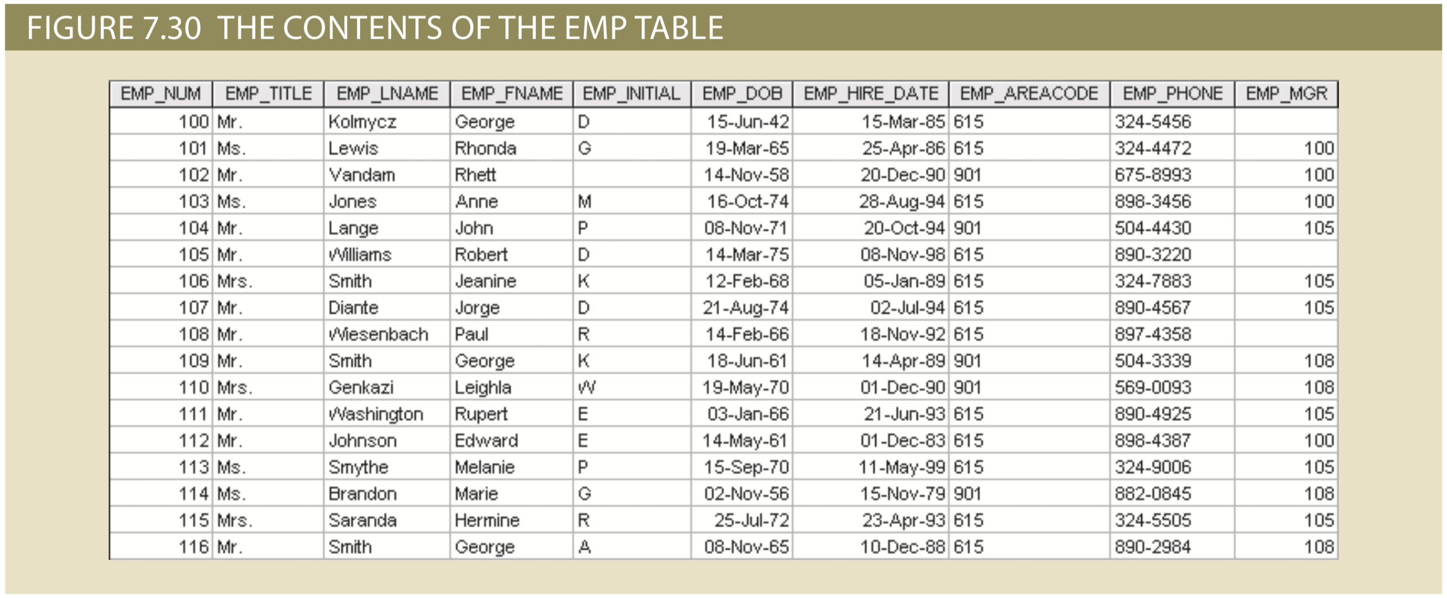

Self-Join

Slide 65
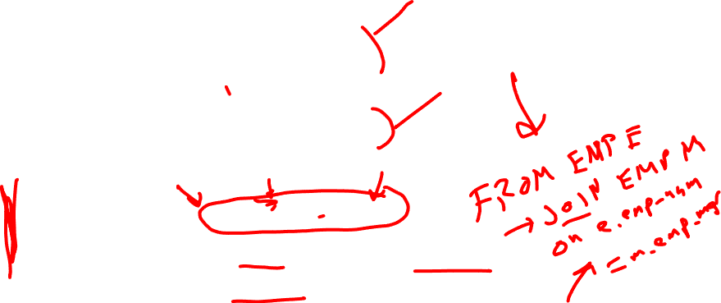
Self-Join
SELECT E.EMP_NUM,
E.EMP_LNAME,
E.EMP_MGR,
M.EMP_LNAME
FROM EMP E, EMP M
WHERE E.EMP_MGR = M.EMP_NUM
ORDER BY E.EMP_MGR;

Slide 66
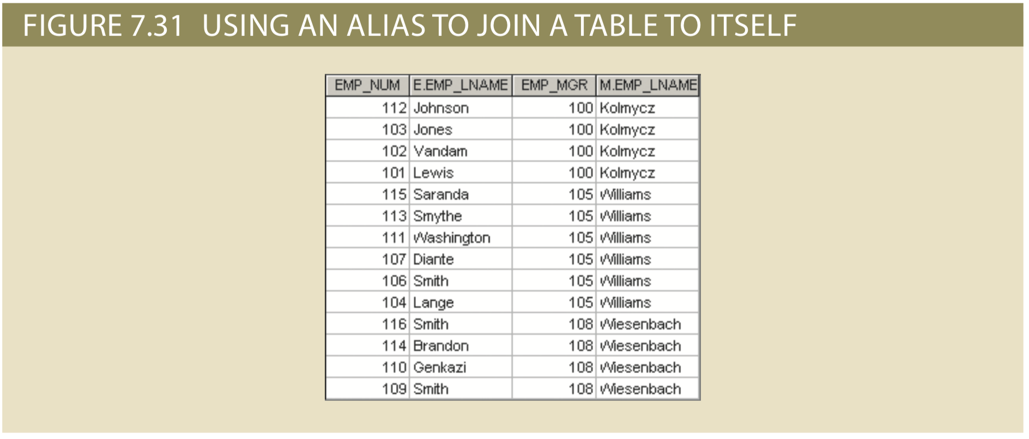

Self-Join

Slide 67
Select
SELECT p_code, v_name
FROM product, vendor
WHERE product.v_code = vendor.v_code;
SELECT p_code, v_name
FROM product
JOIN vendor
ON product.v_code = vendor.v_code;
Implicit
Explicit

Slide 68
USING
SELECT p_code, v_name, vendor.v_code
FROM product
JOIN vendor
ON product.v_code = vendor.v_code;
SELECT p_code, v_name, v_code
FROM product
JOIN vendor USING (v_code)
WHERE product.p_price < 10.00;

Slide 69
SQL Functions
Manipulate numerical, date, or string values
Values may be hardcoded, or table attributes
May appear anywhere in an SQL statement where a value or an attribute can be used

Slide 70
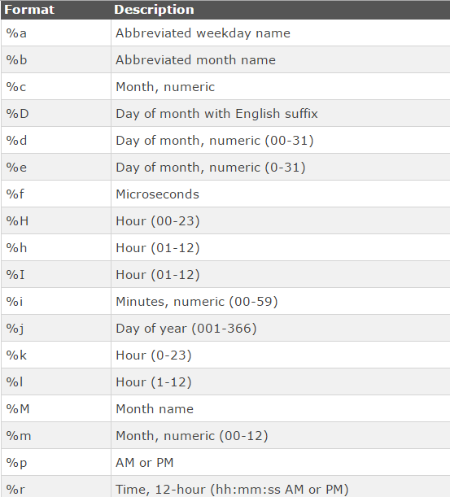
Date Formats

Slide 71
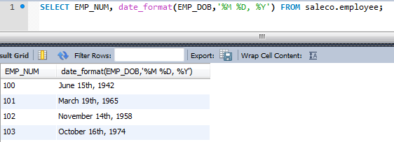
Date Functions

Slide 72
Date Functions
NOW() – Current date time
ADDDATE(date, INTERVAL value addunit)
“date” is DATE, DATETIME, TIMESTAMP
“addunit” is many, MINUTE, HOUR, DAY, etc.
Sixty days from now
ADDDATE(NOW(), INTERVAL 60 DAY)
ADDDATE(NOW(), 60)

Slide 73
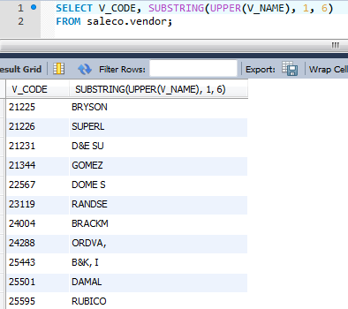
String Functions

Slide 74
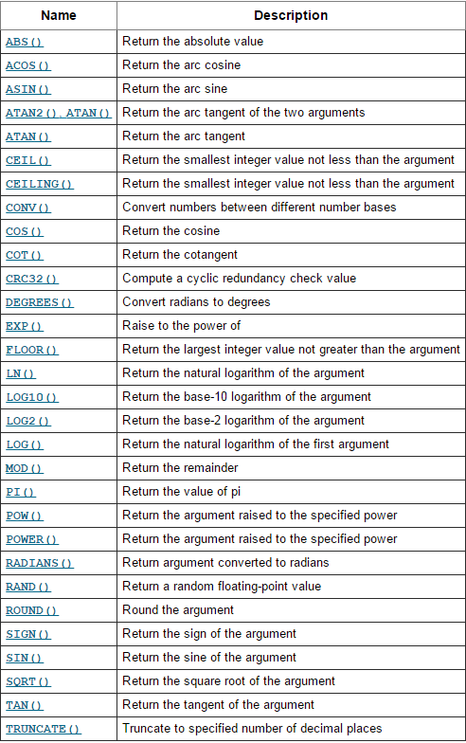
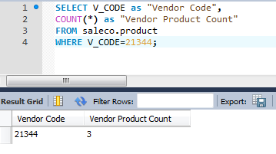
COUNT(*) as “QUANTITY BY VENDOR”
Just a few more functions in the MySQL Math Library
COUNT(*) returns number of rows in result
COUNT(column) returns number of rows that
are not NULL

Slide 75
COUNT
SELECT COUNT(DISTINCT v_code)
FROM product
WHERE p_price <= 10.00;
SELECT COUNT(*)
FROM product
WHERE p_price <= 10.00;

Slide 76

QUIZ
Write a query to find the employee with the most sales.
(COUNT, ORDER BY DESC, LIMIT)
SELECT COUNT(____)
FROM ______
_____ BY _____ DESC LIMIT ___;

Slide 77
Grouping Data
Frequency distributions created by GROUP BY clause within SELECT statement
SELECT column_list
FROM table_list
[WHERE condition_list]
[GROUP BY column_list]
[HAVING condition_list]
[ORDER BY column_list [ASC | DESC]];

Slide 78
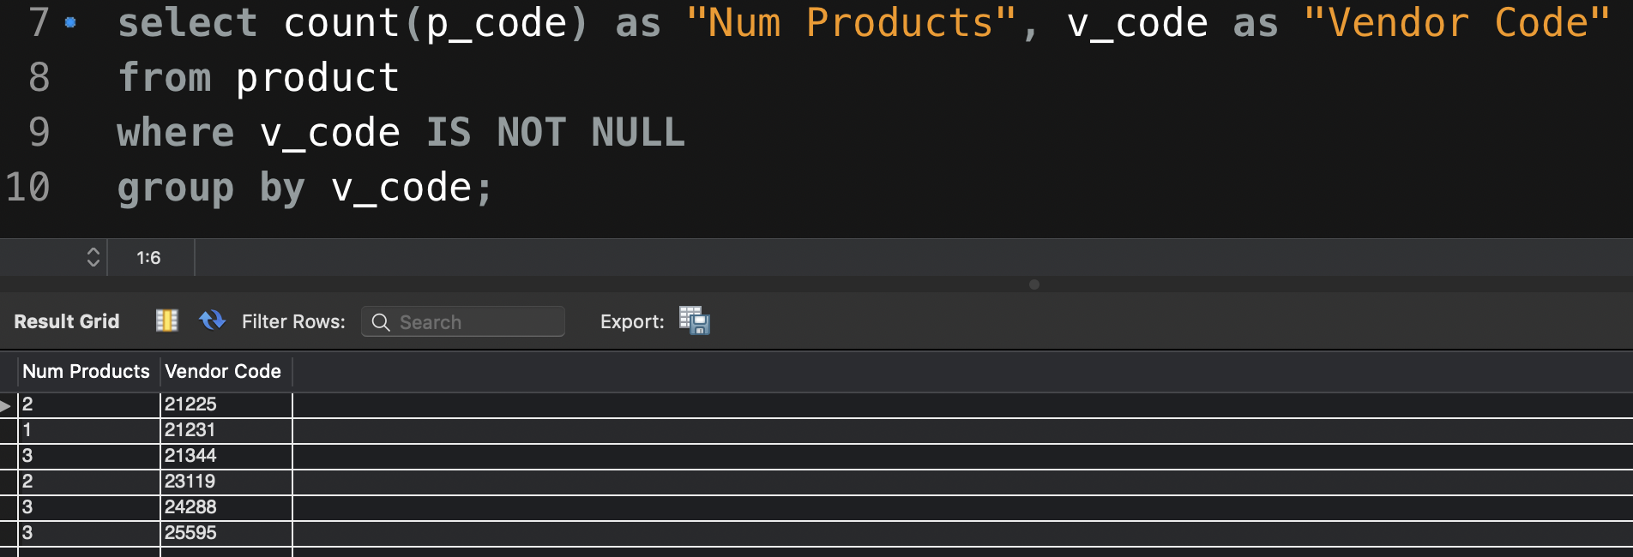
Grouping Data

Slide 79
HAVING Clause
Extension of GROUP BY feature
Applied to output of GROUP BY operation
Used in conjunction with GROUP BY clause in second SQL command set
Similar to WHERE clause in SELECT statement

Slide 80
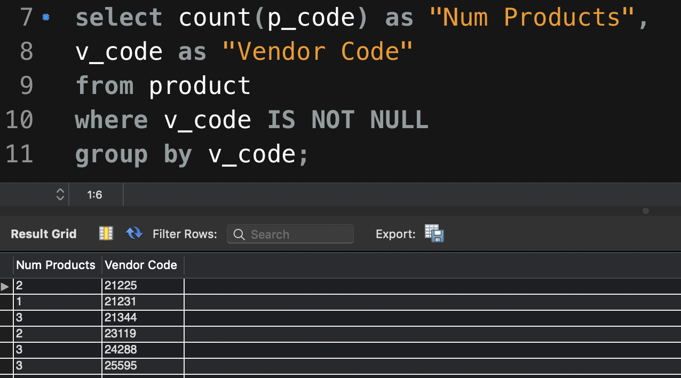
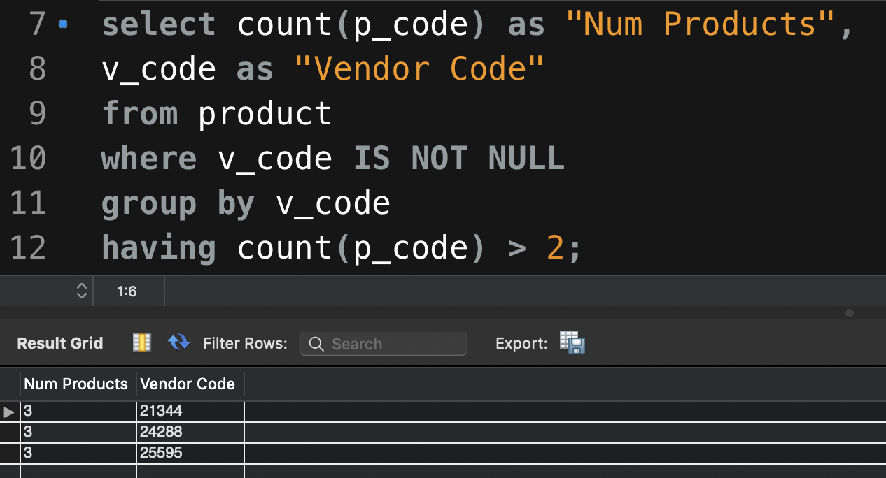
80

Slide 81
GROUP BY
SELECT emp_num, sum(p_price) from line
join sale using(inv_number)
join product using(p_code)
GROUP BY emp_num
ORDER BY SUM(p_price) DESC LIMIT 1;
What is this doing?

Slide 82
GROUP BY with HAVING
SELECT v_code, SUM(p_qoh * p_price) AS totcost
FROM product
GROUP BY v_code
HAVING totcost > 500
ORDER BY totcost desc

Slide 83
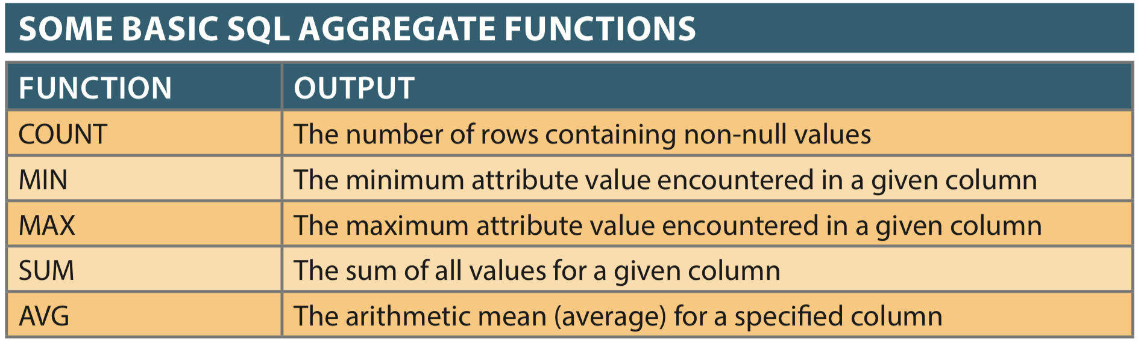
Aggregate Functions
Return a VALUE based on input rows

Slide 84
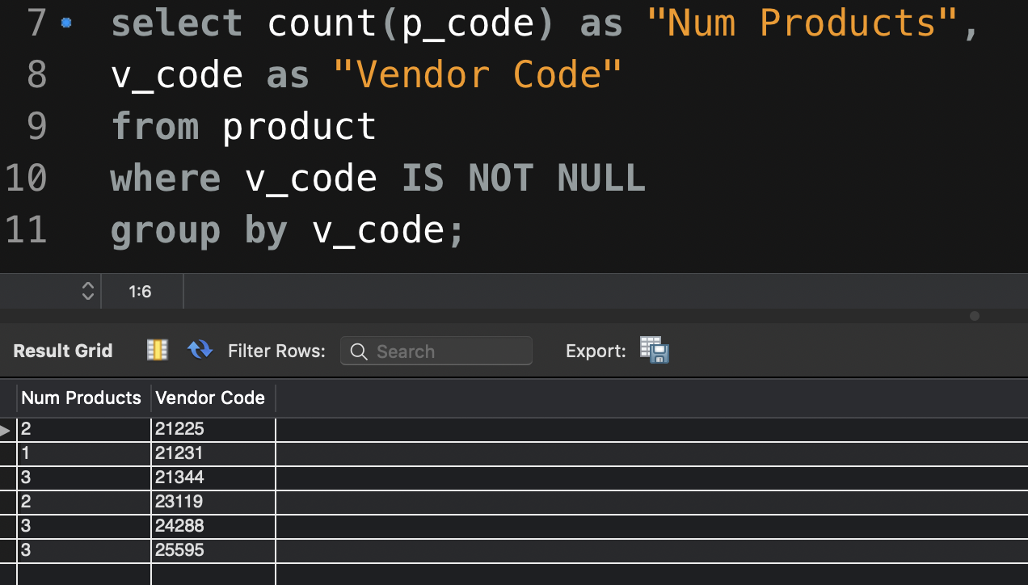
Aggregate Functions and Grouping
GROUP BY clause requires an aggregation to group rows together

Slide 85
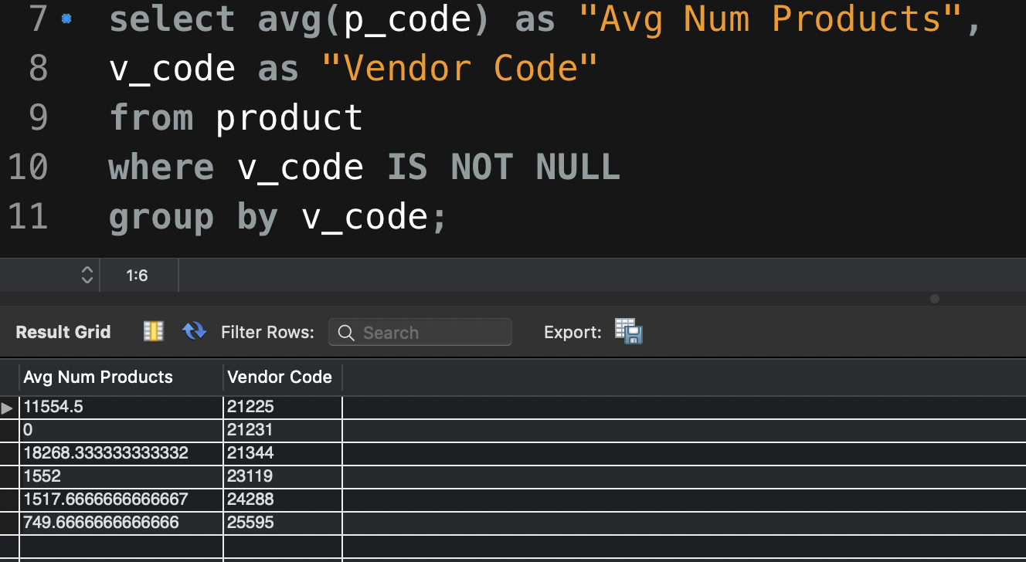

Slide 86
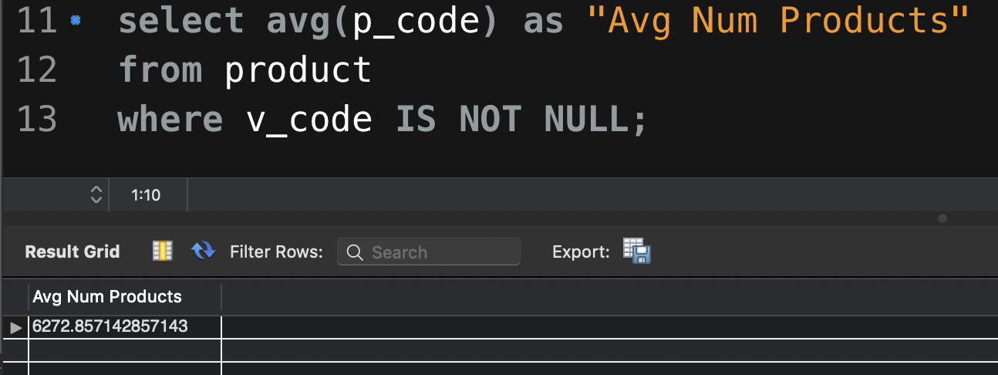
What happened here?

Slide 87

Aggregate function behavior changes in different contexts.
Without v_code and GROUP BY, different behavior.

Slide 88
Aggregate Functions and Subqueries
SELECT p_code, p_descript, p_price
FROM product
WHERE p_price = MAX(p_price);
SELECT p_code, p_descript, p_price
FROM product
WHERE p_price = ( SELECT MAX(p_price)
FROM product);

Slide 89
IN and HAVING Subqueries
IN subqueries
Used to compare a single attribute to a list of values
HAVING subqueries
restricts output of a GROUP BY query by applying conditional criteria to the grouped rows

Slide 90


Example in SaleCo
Inner Query Result

Slide 91

Example in SaleCo
Outer Query Result

Slide 92

Example in SaleCo

Slide 93

Example in SaleCo

Slide 94

Example in SaleCo

Slide 95

FROM subqueries (temp virtual table)
FROM clause:
Specifies the tables from which the data will be drawn
Can use SELECT subquery

Slide 96
Correlated Sub-Queries
Inner query which executes once for each row of the outer query
Similar to a ”for” loop in a procedural language
FOR X = 1 TO 2
FOR Y = 1 TO 3
PRINT “X =“ X, ”Y=“ Y
X = 1 Y=1
X = 2 Y=1
X = 1 Y=2
X = 2 Y=2
X = 1 Y=3
X = 2 Y=3

Slide 97
Line Table

Slide 98

Units Sold Greater Than Average Per Unit
SELECT inv_number, p_code, line_units
FROM line ls
WHERE ls.line_units > (SELECT AVG(line_units)
FROM line la
WHERE la.p_code = ls.p_code);

Slide 99
Stopping Here
SQL homework out Wednesday, will be due two weeks from posting date.
Will be calling project group citations as I read them today.
Read chapter for next week, we will be covering:
Virtual tables and Views
Stored Procedures
Functions
Common table expressions
Triggers
Procedural MySQL

